Slide 1
The Library is the Heart of the Community
WLA Midwinter Conference
January 29, 2020
Susanne Markgren & Linda Miles

Slide 2
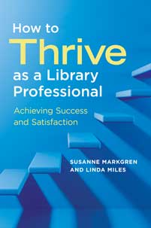
How to Thrive as a library Professional
Notes:
This book grew out of a love for what we do and a passion for helping others discover and cultivate pathways to successful, satisfying, and thriving professional careers. We work in different libraries, in different roles, and have different backgrounds, experiences, and skills. Yet we have collaborated over the years on developing a variety of professional development opportunities for students, job seekers, and librarians (both new and seasoned).
Along the way we’ve enjoyed hundreds of collegial relationships and participated in thousands of conversations about becoming a professional and building a practice. In recent years, we’ve witnessed a growing demand for programming to assist people with some of the challenges and struggles they feel as they seek direction and meaning in the profession, adapt to new roles, go up for promotion or tenure, or simply work to find a job. Many of the concepts, exercises, and questions that are included in this book grew out of our collaborative programming.

Slide 3

Librarian Personas
https://www.pikrepo.com/ffepe/silhouette-of-people-on-a-banquet-hall
Creative Commons Zero - CC0
Notes:
In the first chapter, you will be introduced to five professional personas, giving you a taste of what librarianship is like, day to day, in different contexts. Joy is a branch manager in a public library, Marcus is a school librarian, Amir works in a special library in the financial services industry, Sana works at a small liberal arts college, and Camila is an archivist for a literary society. Throughout the book, we will rely on these personas to provide concrete examples of some of the challenges and practices discussed. These people are composites, their experiences and attitudes drawn from those of people we have met along our own professional journeys or pulled from situations and obstacles and relationships we’ve experienced ourselves. Their individual stories help to illustrate specific circumstances, as well as problems, actions, and solutions. We’ve attempted to design the persona narratives in any given chapter to stand on their own.
In our presentation and discussion today, we will talk briefly about of the 7 chapters in the book, and then take a deeper dive into 2 specific chapters: Relationship building, and forming habits for professional growth. Then, we will introduce a few exercise, do some individual journaling and writing, the small group discussions, and then we’ll open it up for a whole group share back, and Q&A.

Slide 4
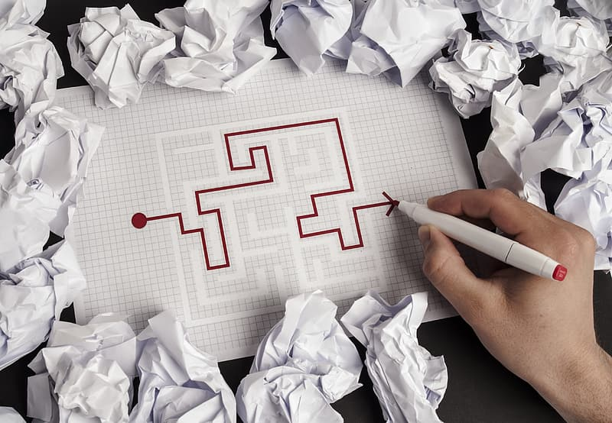
What is success?
https://www.pikrepo.com/fiaao/person-holding-white-printer-paper
Creative Commons Zero - CC0
Notes:
Success is whatever you want it to be--or whatever you need it to be at a given moment. That is to say, what success looks like can certainly change with context. It might be a feeling, or a tangible objective. For this book, we think of professional success (or the quest for success) as both a daily challenge and a long-term goal. Our focus is on a steady, deliberate, and also creative approach to building your professional practice. It’s a journey, from establishing a vision of where you’re headed, to recognizing milestones reached along the way. Each of us interprets, pursues, achieves, and celebrates success differently. Success is also rarely (if ever) “won and done.” It requires some maintenance and care.

Slide 5

Forging a path: Career Vision
People who take the plunge, who commit themselves to going after what they really want, often… begin to attract to themselves the knowledge, relationships, and resources they require to accomplish their work.
– Boldt, L.G. (2004) How to find the work you love.
https://www.pikrepo.com/fvmiy/round-brown-framed-eyeglasses-on-red-hardbound-book
Creative Commons Zero - CC0
Notes:
This chapter provides information and exercises for reflection, aimed at getting you moving in the direction that’s right for you.

Slide 6

Gathering and Lending Support: Relationships
Finding your tribe offers more than validation and interaction, important as both of those are. It provides inspiration and provocation to raise the bar on your own achievements.
– Robinson, K. 2009. The element: How finding your passion changes everything.
https://www.pikrepo.com/feaqm/man-and-woman-holding-hands
Creative Commons Zero - CC0
Notes:
This chapter features discussion and exercises related to how relationships contribute to “flourishing” at work, how networks function and how benefits circulate among individuals, developing different types of supportive relationships, and cultivating positive network behaviors.

Slide 7
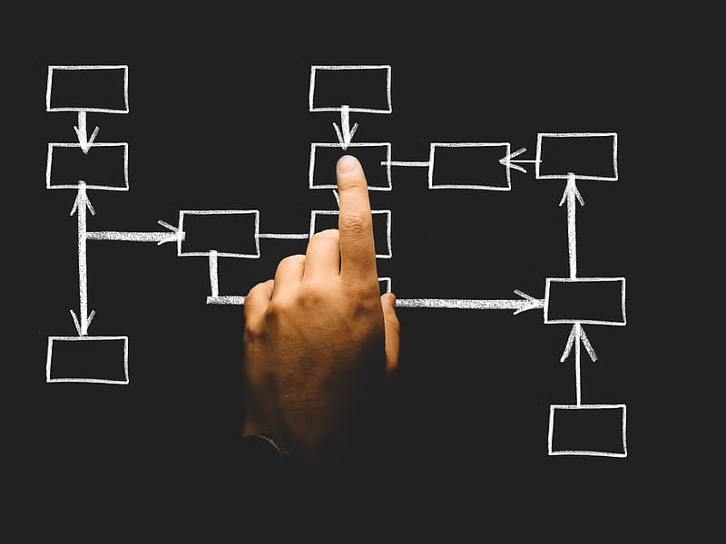
Getting Your Bearings: Understanding Organization Culture
For collaboration to work, the library organization must embrace the team concept and empower its employees to make decisions.
– Henry, Eshelman, Moniz, 2018, The dysfunctional library: Challenges and solutions to workplace relationships.
https://www.pikrepo.com/fiopa/organization-organization-chart
Creative Commons Zero - CC0
Notes:
This chapter looks at the complex systems that make up organizational culture and provides approaches to “decoding” culture and developing a relationship to culture that is empowering and engaged.

Slide 8
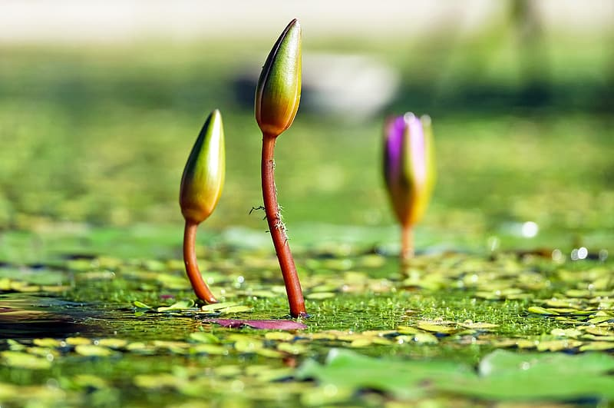
The Choices We make: Creating habits for Professional growth
It takes skill to bring something you’ve imagined into the world: to use words to create believable lives, to select the colors and textures of paint to represent a haystack at sunset, to combine ingredients to make a flavorful dish. No one is born with that skill. It is developed through exercise, through repetition, through a blend of learning and reflection that’s both painstaking and rewarding. And it takes time.
– Tharp, T., 2006, The creative habit.
https://www.pikrepo.com/flrpm/depth-of-field-photograph-of-water-lilies
Creative Commons Zero - CC0
Notes:
The exercises in this chapter help you assess old habits, increase focus and productivity, develop healthy “habits of mind,” and approach habit formation in a way that helps make them “stick.”

Slide 9

Telling our Stories: using narrative for self-promotion, professional development, and influence
The average person today is inundated with facts and data, and we let most of this pass through our brain with minimal retention or reaction – unless something makes the information stand out in a meaningful way. That’s where story comes in.
– Choy, E., 2017, Let the story do the work.
https://www.pikrepo.com/fizbn/one-upon-a-time-hand-written-text-qoute
Creative Commons Zero - CC0
Notes:
This chapter takes you through the structures and elements of stories and provides exercises related to using narrative as a way to “get the work done” day-to-day, as well as for self-knowledge and self-promotion.

Slide 10

Finding Your Place: Mindfulness and Self-Compassion
Mindfulness provides a simple but powerful route for getting ourselves unstuck, back in touch with our own wisdom and vitality. It is a way to take charge of the direction and quality of our own lives.
– Kabat Zinn, 1994, Wherever you go, there you are: Mindfulness meditation in everyday life.
Self compassion is a portable source of friendship and support that is available when we need it most—when we fail, make mistakes, or struggle in life.
– Neff and Dahm, 2015, Self-compassion: What it is, what it does, and how it relates to mindfulness.
https://www.pikrepo.com/fpkxb/be-here-now-sticker-on-wall
Creative Commons Zero - CC0
Notes:
Discussions and exercises in this chapter provide opportunities to reflect on what is energizing or, alternatively, draining in your current practice, assess your role in certain workplace dynamics in order to devise a plan of action, respond productively to stressful situations, and develop a compassionate approach to self-evaluation and interactions with others.

Slide 11

Discovering your true purpose: reflective practice
By developing the ability to explore and be curious about our own experience and actions, we suddenly open up the possibilities of purposeful learning—learning derived not from books or experts, but from our work and our lives.
--Amulya, 2011, What is reflective practice?
https://www.pikrepo.com/fmauy/white-boat-on-dock-near-green-trees-during-daytime
Creative Commons Zero - CC0
Notes:
Discussions and exercises in this chapter address getting started and integrating reflection in your practice, building successful reflective habits, and implementing reflective strategies in collaborative efforts or groups.

Slide 12
Gathering and Lending Support: Relationships
Gathering and Lending Support: Relationships

Slide 13

Gathering and Lending Support: Relationships
Nearly every day brings an opportunity to build the relationships that woven together make up your lifelong professional community. The key is to approach this not so much as an investment in your career success but rather as one of the riches rewards of life: being in a position to support others.
– Dority, G.K. 2016. Rethinking Information Work.
Notes:
Amir, our special librarian, maintains a complicated network of professional relationships. There is Amy, another librarian, who took him under his wing when he joined the firm and has provided various types of support since. There are a few individuals with whom he collaborates on multiple projects or initiatives, those with whom he socializes a bit, and just one or two who occasionally bring along family members to the backyard picnics hosted by Amir and his husband. Amir is not such a naturally outgoing guy, but has had to work hard to cultivate effective networking behaviors and make himself an attractive candidate for support or promotion.
We all know that relationships are beneficial – it’s common sense.
Some traditional ways of thinking about the benefits of good work relationships:
Task assistance
Career advancement (meaning advice and sponsorship)
Emotional support

Slide 14
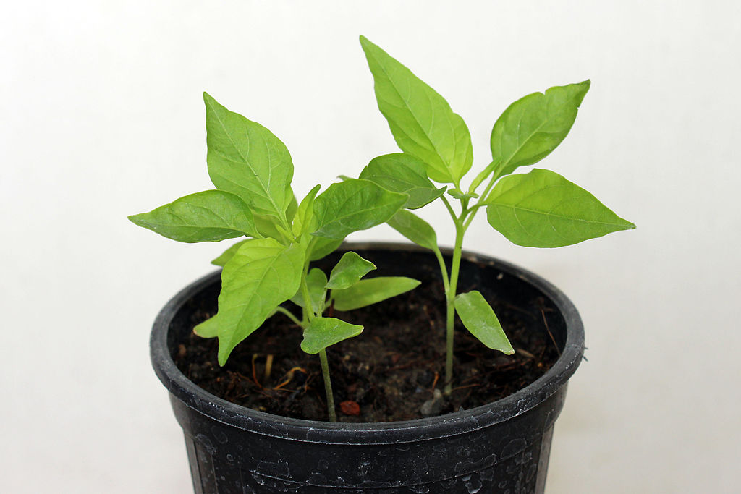
Flourishing at work
Flourishing … (Thriving)
It means you are winning in your current situation. It means you are on top of your game.
– Flourish King, urbandictionary.com.
https://commons.wikimedia.org/wiki/File:Carolina_Reaper_30_days_Plant.JPG by Suyash Dwivedi CC-BY
Notes:
We all know that relationships are beneficial – it’s common sense.
Some traditional ways of thinking about the benefits of good work relationships:
Task assistance
Career advancement (meaning advice and sponsorship)
Emotional support

Slide 15
Functions and effects of work relationships
From Colbert, bono, and puranova (2016)
Traditional functions of work relationships | Additional functions theorized by Colbert, Bono, and Puranova (2016) | Effects of flourishing
Task assistance Career advancement (advice and sponsorship) Emotional support | Friendship Personal growth and development Opportunities to support others | Job satisfaction Positive emotions at work Life satisfaction More meaningful work
Notes:
Researchers Amy E. Colbert, Joyce E. Bono and Radostina K. Purvanova
Decided to consider some additional functions:
Friendship
Personal growth and development
Opportunities to support others
Taken together, they theorize, adds up to a kind of flourishing:
Job satisfaction
Positive emotions at work
Life satisfaction
More meaningful work

Slide 16
Why network?
Findings from Colbert, bono, and puranova (2016)
Type of relationship benefit | Positive outcome (“flourishing”)
Feeling supported in specific tasks or objectives | Significant impact on job satisfaction
Friendship (enjoying each other’s company, sharing confidential information, spending time together outside of work) | Significant impact on positive emotions at work
Personal growth (being challenged and supported, having role models) | Significant impact on life satisfaction
Having opportunities to help others | Significant impact on more meaningful work
Notes:
These researchers surveyed workers from a variety of occupations, asking whether certain types of relationship benefits were linked with any of the effects of flourishing.
Additional benefits of positive professional relationships may include:
Shared interest in concepts, issues, areas of work
Shared sense of purpose
A sense of belonging and solidarity – camaraderie
Development of a professional identity

Slide 17
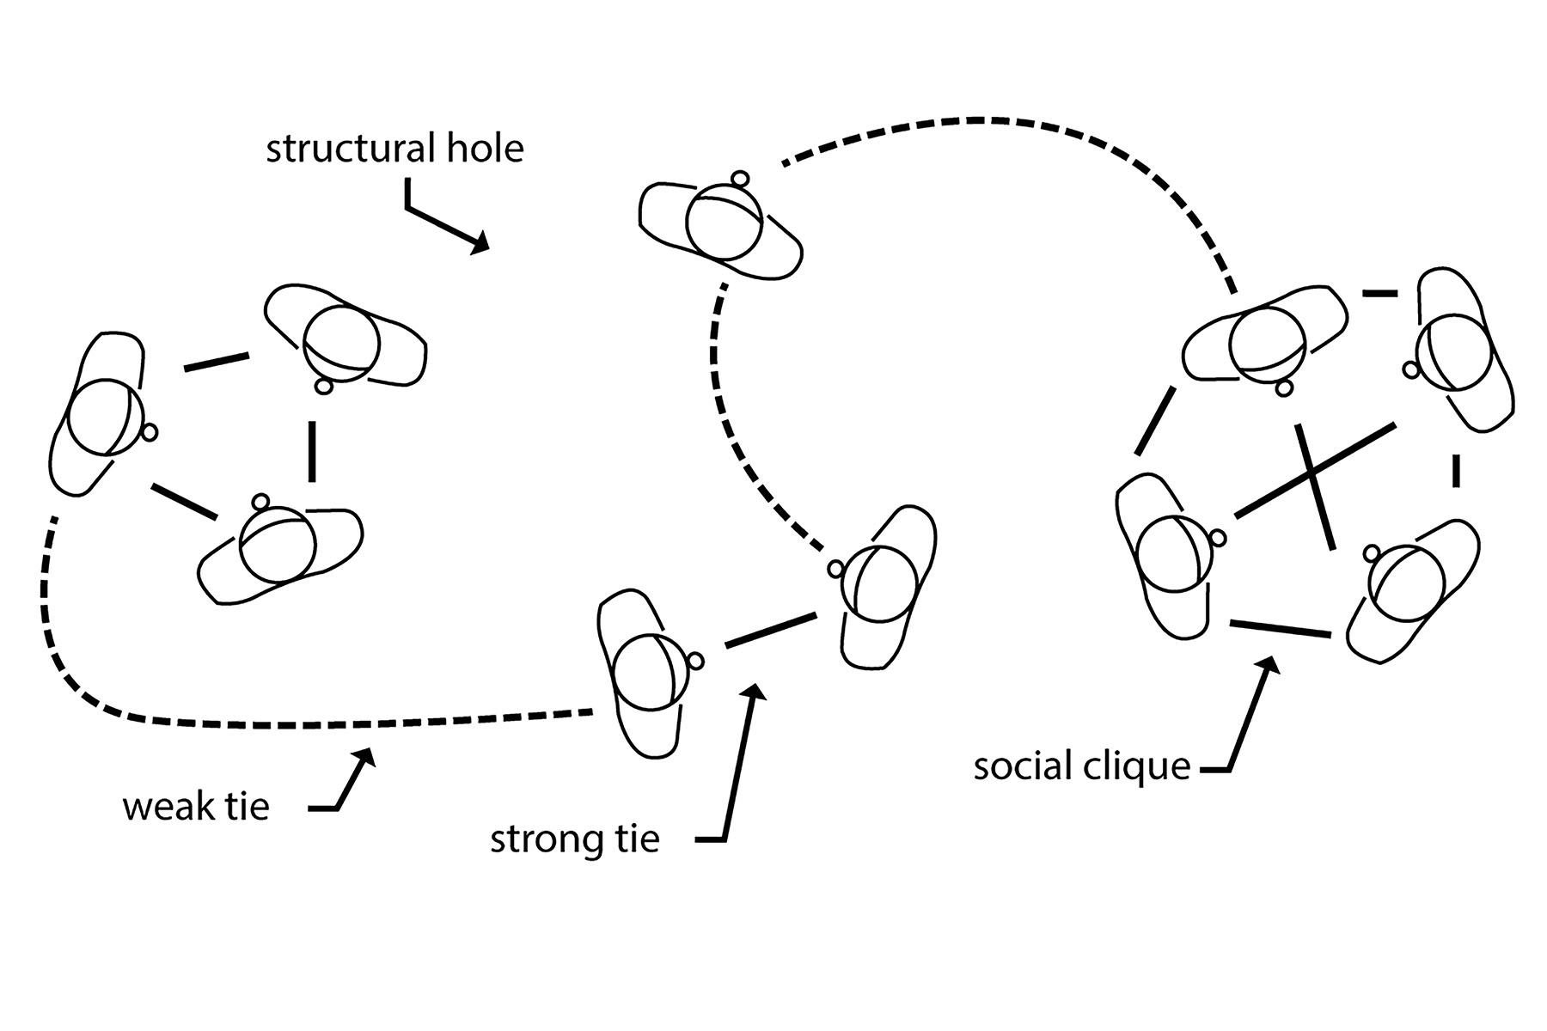
Social networks
Granovetter (1973)
Adapted from a work in the public domain.
Notes:
Each individual = “node”
Connected via “ties”
Strong ties
“social cliques” share multiple, very strong ties with frequent, often emotional interactions and multiple concurrent relationships
Through strong, redundant, and overlapping connections, clique members share information quickly and easily and garner support from each other in many ways
Trust increases
Network norms are reinforced
Weak ties
Beyond your close circle of friends
Single type of relationship, less overlap
Less frequent, less intense interactions
Structural holes
One person has ties to two or more nodes, but they are not tied to each other
You would think that stronger ties are always better, right?
Wrong! Actually with weak ties and structural holes you may be positioned as someone who has rare or valuable information
Amir and Alicia, his company’s compliance officer, are working on a project together. They share a weak tie, Beyond the few members of their task group, they don’t share connections with other nodes. Through participation on the project, Amir is positioned well to provide his supervisor with the kinds of information he garners there, to which his supervisor wouldn’t otherwise have access. This is because, within Amir’s network, there is a structural hole between his supervisors and members of the task group.
It may seem counterintuitive to aim to cultivate weak ties and structural holes, but research supports the idea of these as valuable in their own right.

Slide 18

Social capital
Granovetter (1973)
Social capital is the goodwill available to individuals or groups. Its source lies in the structure and content of the actor’s social relations. Its effects flow from the information influence, and solidarity it makes available to the actor.
– Adler, P.S., & Kwon, S.-W. (2002) Social Capital: Prospects for a new concept
https://svgsilh.com/image/304616.html Released under Creative Commons CC0
Notes:
“Social capital” = the value that derives from all of these connections, created through interactions among members:
Information
Influence
Advantage
Invested, traded, or consumed

Slide 19
Networking behaviors and impact
Findings from forret and Dougherty (2004)
Networking behaviors | Impact on promotions, compensation, perceived career success
Internal visibility (through task assignments, participation on committees, etc.) | Significant impact on promotions, salary, and perceptions of success
Participating in professional activities (through professional organizations, speaking engagements, etc.) | Significant impact on salary and perceptions of success
Socializing (through work functions, athletics, or getting together outside of work, etc.) | Marginal impact on perceived success only
Maintaining external professional relationships (beyond the organization) | Less than marginal impact on all three measures
Participating in community activities (outside of the workplace) | Less than marginal impact on promotions only
Notes:
Researchers Forret and Dougherty, who published findings in both 2001 and 2004, identified 5 categories of networking behavior (left column)
And all of these seem like they would be beneficial for a professional career, right?
They then measured the effect of those behaviors on specific career outcomes:
Promotions
Compensation
Perceptions of career success

Slide 20
Chapter exercises
Relationship Journaling | Reflective activity re-considering your thinking about the value of work relationships in general, and then examining your key relationships in more detail.
Network Mapping | Putting the concepts of nodes, strong and weak ties and structural holes to pen and paper, as you analyze your current network and identify potential new connections.
Roles and Types of Support | An exercise that prompts you to analyze each of your key relationships according to what type of relationship it is and what types of support or benefits are afforded.
Networking Behaviors Worksheet | Examining your current network behaviors and identifying opportunities for future participation

Slide 21
Habits for Focus, Time Management, and Getting Things Done
Notes:
Before she took up her current position, and right after library school, Sana worked as a serials librarian at a suburban community college. It was exciting at first. To be honest, there was a lot to love about the job: working with librarians and faculty to identify the best disciplinary resources, evaluating cost-per-use metrics, establishing productive relationships with vendors, and troubleshooting access issues. She settled into the routines of the job and flourished. But over time, evolution took over evolution of libraries, of users, of serials themselves. In the gradual diversification of her responsibilities to include more public service, project management, and cross-campus collaboration, Sana found that the habits and routines she had successfully managed for several years were no longer serving her best interests. She was bored with certain parts of her job and overwhelmed by some of her new responsibilities, which led to a lack of focus and a loss of energy. She was still devoted to the institution, loved working with her colleagues and supporting the faculty and students, and enjoyed learning new things, but she knew that she wasn’t meeting the expectations of her director and knew that her productivity was increasingly falling short.
The irregularity of our roles and the ever-changing nature of our profession can be a draw for those who crave variety and enjoy learning new things. Librarianship, thankfully, is rarely boring, and library professionals rarely spend their days doing the same tasks with the same routines over and over again. Our daily responsibilities vary greatly by type of institution, job role, community of library users, and personal and professional backgrounds and motivations. The work of an academic serials librarian is very different from that of a children’s librarian in a public library setting, or a corporate law librarian, or a medical information specialist. But all of our roles are constantly being redefined and reimagined so that we can keep up with changing technologies, workflows, and patron/client expectations. No matter what role we are in—or hope to be in—at some point we will be simultaneously pulled in many different directions, making it difficult to prioritize one thing at a time, to make decisions, and to get out of our heads in order to focus and move forward with the next goal, project, position, or achievement.

Slide 22

The Choices We make: Creating habits for Professional growth
Habits are powerful factors in our lives. Because they are consistent, often conscious patterns, they constantly, daily, express our character and produce our effectiveness
– Covey S.R., 1990, The 7 habits of highly effective people

Slide 23
Exercise: Five Steps to Getting Things Done
Collect : On one page of your journal, write down everything you can think of that needs to get done, and anything that’s on your mind or keeping you up at night—in no particular order. Include notes from past weeks for continuing projects or issues.
Process : Create a page for each project or issue. Transfer any outstanding items from the previous week’s notes and jot down any new information or ideas—again, in no particular order.
Organize : For each project, consider level of importance and urgency. Set priorities for action today, this week, and/or this month. Track tasks with important deadlines in a calendar.
Review : Each day of the week, review to prioritize tasks for the day. What is the next action for each project?
Do : Jump right in! Focus on those next actions.
(Adapted from Allen [2001] Getting things done: The art of stress-free productivity. New York, NY: Penguin Books.)
Notes:
Becoming overwhelmed and paralyzed by details and deadlines of the many, many tasks on our plate is one potential consequence of a very busy work life. If we spend too much time worrying about all the things we need to do, we may never get around to actually doing them. You want to keep all those balls in the air, but somehow manage them. David Allen, in Getting Things Done: The Art of Stress-Free Productivity (2001), emphasizes the importance of capturing all the things that need to get done—now or later, big or little—so you don’t lose them, putting them into a logical and trusted system outside of your brain, and then disciplining yourself to make deliberate decisions to plan and accomplish your priorities (p. 3). By getting these things out of our heads, and organizing and processing them, we can stop trying to keep track of everything all at once. We gain focus for increased productivity. Allen describes a five-stage approach: 1) collect; 2) process; 3) organize; 4) review; and 5) do (p. 24).

Slide 24
Exercise: The Eisenhower Matrix
Sort all of the tasks and responsibilities and worries that you can think of related to your work using an Eisenhower box in your journal.
Take action using the 4Ds—depending on urgency/importance:
Do It (Urgent/Important): If the action really needs to be done by you, and can be done quickly (in less than two minutes), then do it
now.
Defer It (Not Urgent/Important): If you are the right person for the job but it can’t or doesn’t need to happen right now, then defer it
until later. Put it in a “next action” list and on your calendar as a reminder.
Delegate It (Urgent/Unimportant): If it needs to get done, but it isn’t your responsibility, or if someone else can do it sooner, then delegate it.
Dump/Ditch It (Not Urgent/Unimportant): If it doesn’t matter and doesn’t need to be acted on now, delete it. Get it out of your head.
Notes:
Sorting is another strategy for productivity that can be cultivated as a habit or routine. This is especially useful for taming an overflowing email inbox, tidying a desk or office, etc.

Slide 25
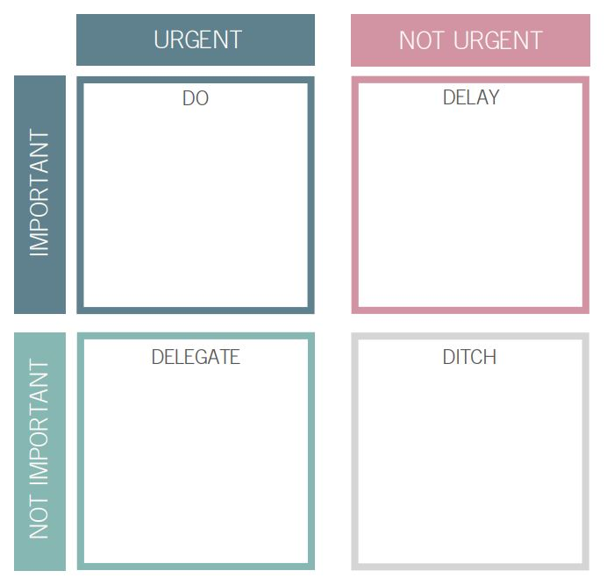
The Eisenhower Matrix
https://theassistantquarters.co.uk/how-to-delegate/

Slide 26
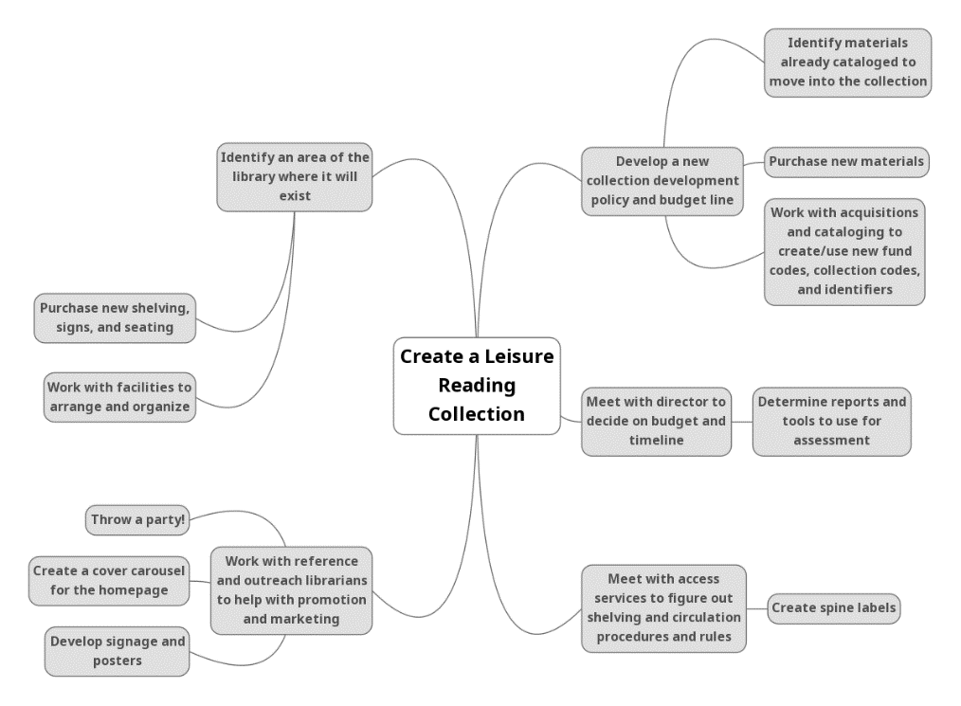
Mind Mapping
Notes:
If your work frequently involves decision making related to specific projects or goals, mind mapping may be a useful and creative habit to develop for brainstorming and bringing into focus potential choices or actions. A mind map is basically a visual representation of related information or ideas. It is something tangible and customizable, which can help you perceive multiple dimensions of a complex subject, visualize options for decision-making very clearly, and determine what needs to be done next. Mind mapping is a particularly great strategy for visual thinkers.
Using pen and paper, or a mind-mapping app or tool (see below), create a mind map.
Put your main topic/project/focus/task in the center
Building outward, represent related elements or sub-tasks, drawing connections to show how they are related
Mind maps are great tools for collaboration and group work, and are useful for generating feedback and input from project stakeholders. They can spur brainstorming and creativity or help make decision-making options (and potential consequences) apparent.
Step back and take a look at the big picture
Ask yourself questions to determine how to focus on the information at hand, such as: Where do decisions need to be made? What are the key priorities? What are the next tasks related to each area of work? Who should do them? When? What resources are needed?

Slide 27
Chapter exercises
Habits Checklist | Create a table or spreadsheet describing current habits, expectations for each, and when they occur.
Developing Writing Habits | Reflective exercise to create habits to enhance productivity and accountability.
What’s Your Mindset? | This exercise asks questions about fixed and growth mindsets as they relate to specific abilities.
Attachment Style | Identify kinds of attachments styles, how they are characterized, and consider ways to build new habitual responses based on potential actions.
Habits of Mind Worksheet | Reflect on opportunities to practice and solidify positive habits of minds.
Six-Step Habituation | Focusing on one new habit, follow a six-step blueprint to help solidify it.

Slide 28
Q&A

Slide 29
Time for Exercises

Slide 31
Thank you & Questions
Linda Miles
lmiles.librarian@gmail.com
@lmiles
Susanne Markgren
susanne.markgren@manhattan.edu
@smarkgren
Web Site: https://thriveasalibraryprofessional.com/

